Slide 1
Keypoint Application: Panorama
Juan Carlos Niebles and Jiajun Wu
Stanford Vision and Learning Lab
Slides by Shubhang Desai

Slide 2
Outline
Quick review of keypoints and RANSAC
Panorama formulation
Matching corresponding keypoints
Stitching images together with affine transformation

Slide 3
Outline
Quick review of keypoints and RANSAC
Panorama formulation
Matching corresponding keypoints
Stitching images together with affine transformation

Slide 4
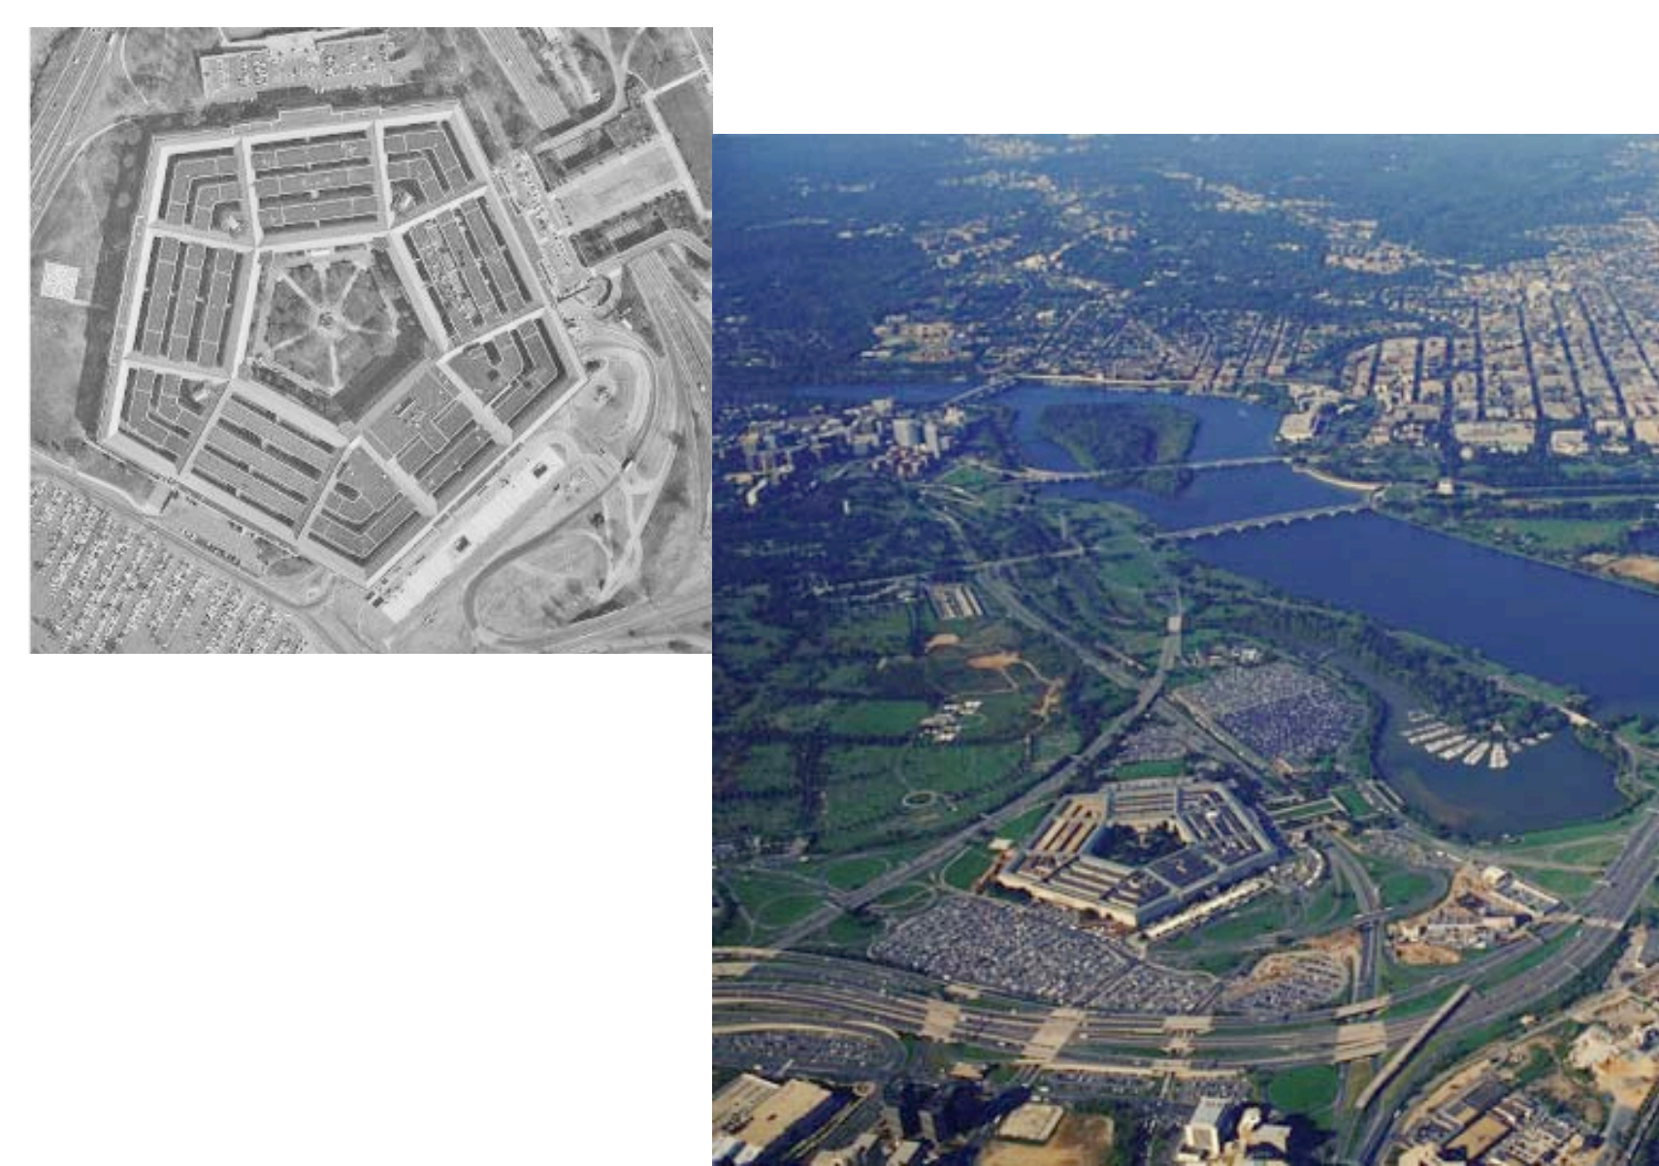
What are keypoints?
Reliable, unique points in images which can be used to find corresponding regions in different images of the same scene

Slide 5
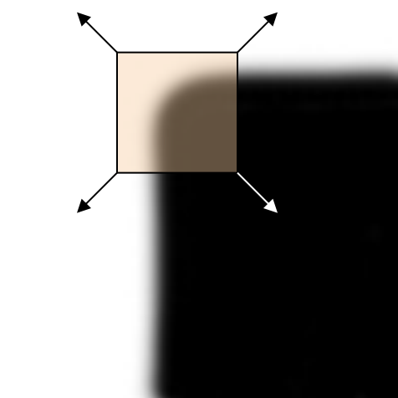
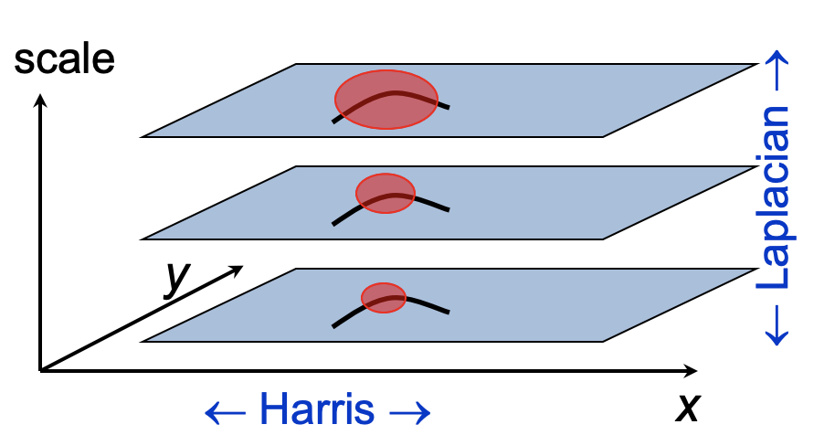
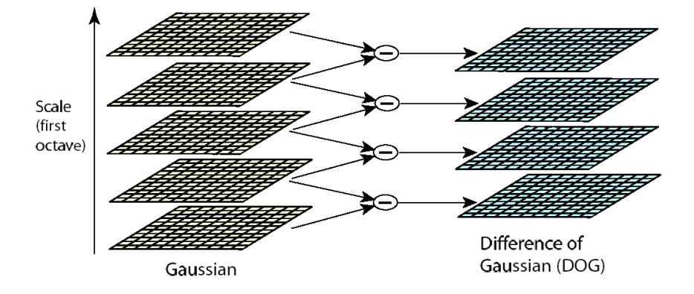
Finding keypoints
SCALE INVARIANT
Harris Corner Detector
Use gradient Eigenvalues to find corners at a certain scale
Harris-Laplacian
Find keypoints using Harris and scale using Laplacian filter
DoG
Use DoG filters to find keypoints across space and scale

Slide 6
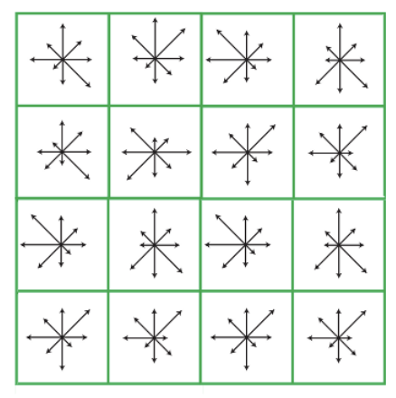
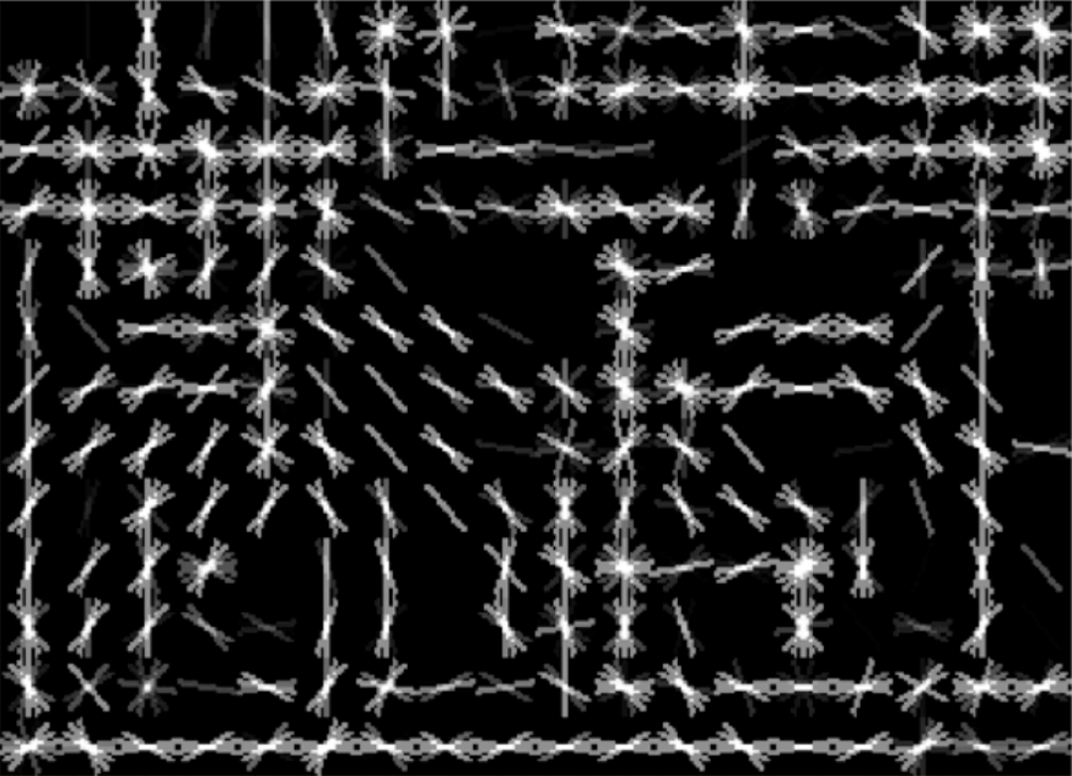
Describing keypoints
ROT. + SCALE INVARIANT
SIFT Descriptor
Keypoints as histogram of normalize gradient orientation
HoG
Region (or image) as histograms of local gradients

Slide 7
RANSAC – algorithm for model fitting
Repeat n times:
Sample and form hypothesis
Find number of inliers
If max_inliers, save model
Recompute model on inliers

Slide 8
RANSAC – algorithm for model fitting
Repeat n times:
Sample and form hypothesis
Find number of inliers
If max_inliers, save model
Recompute model on inliers

Slide 9
RANSAC – algorithm for model fitting
Repeat n times:
Sample and form hypothesis
Find number of inliers
If max_inliers, save model
Recompute model on inliers

Slide 10
RANSAC – algorithm for model fitting
Repeat n times:
Sample and form hypothesis
Find number of inliers
If max_inliers, save model
Recompute model on inliers

Slide 11
RANSAC – algorithm for model fitting
Repeat n times:
Sample and form hypothesis
Find number of inliers
If max_inliers, save model
Recompute model on inliers

Slide 12
Outline
Quick review of keypoints and RANSAC
Panorama formulation
Matching corresponding keypoints
Stitching images together with affine transformation

Slide 13
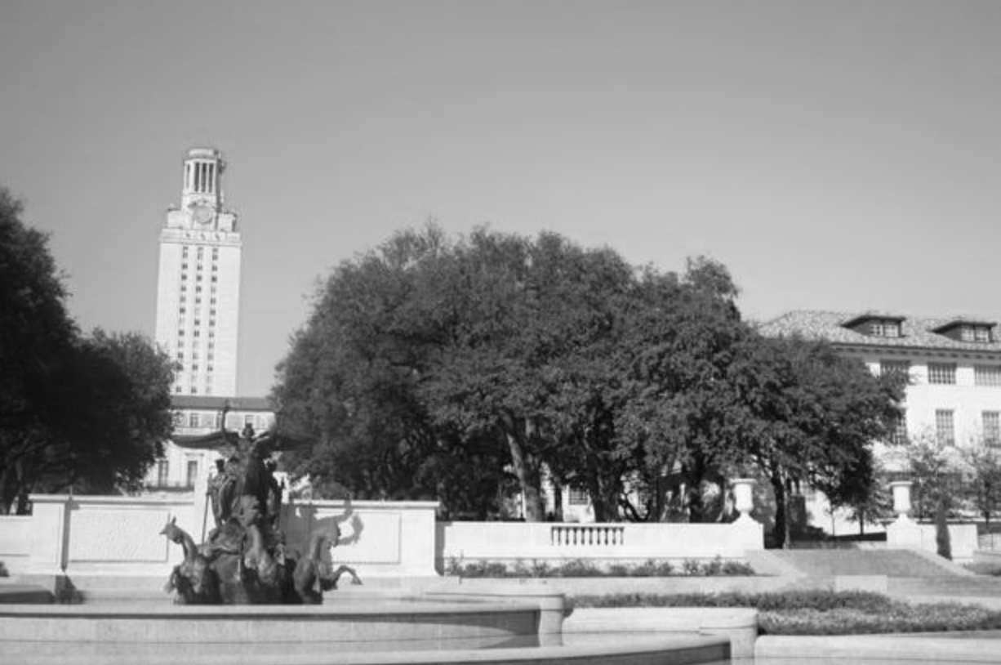
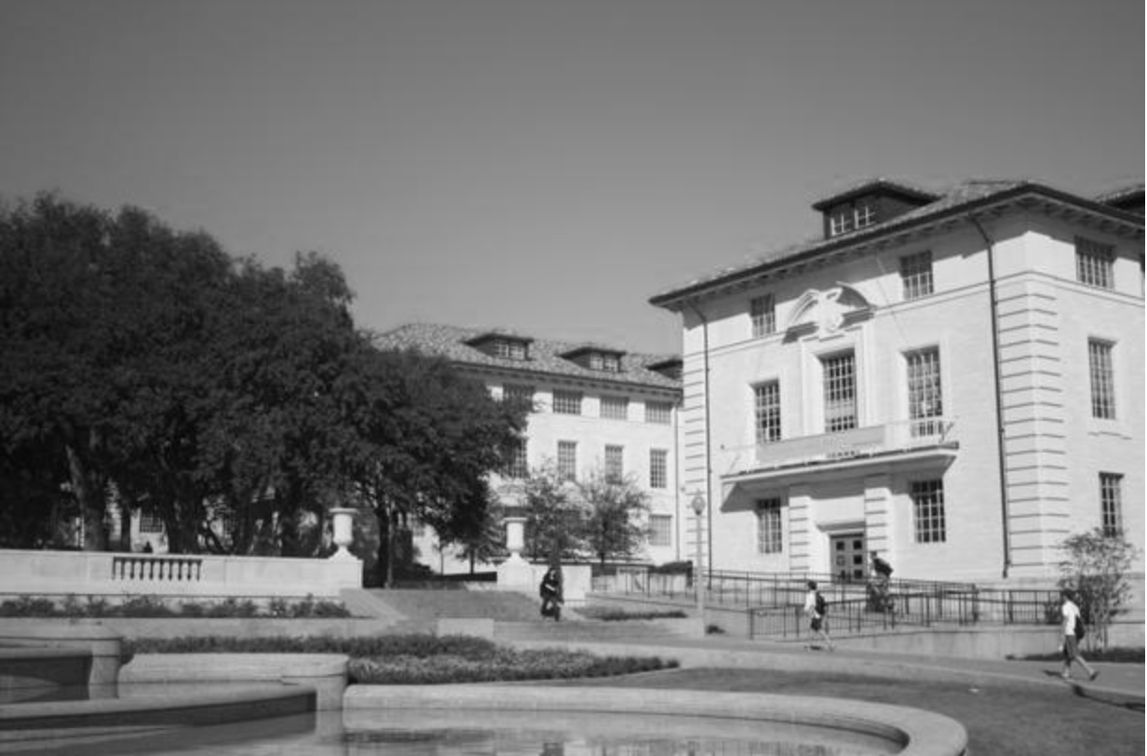
Panorama

Slide 14
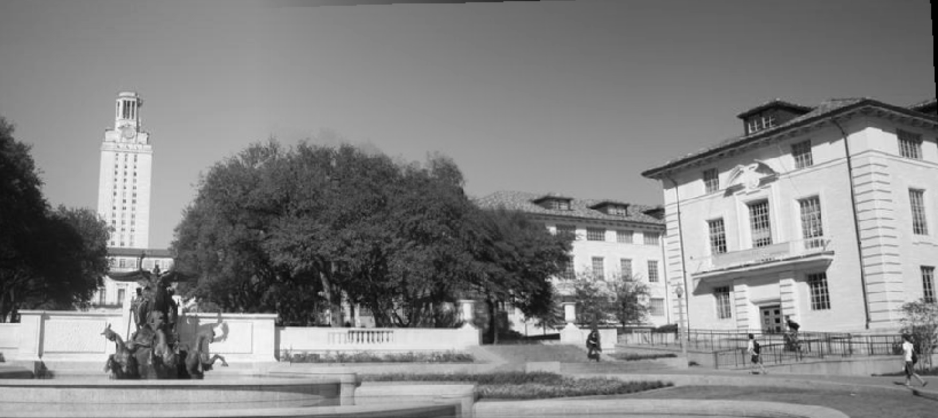
Panorama

Slide 15
Key insight: leverage corresponding keypoints

Slide 16
Problem 1: how to match keypoints?

Slide 17
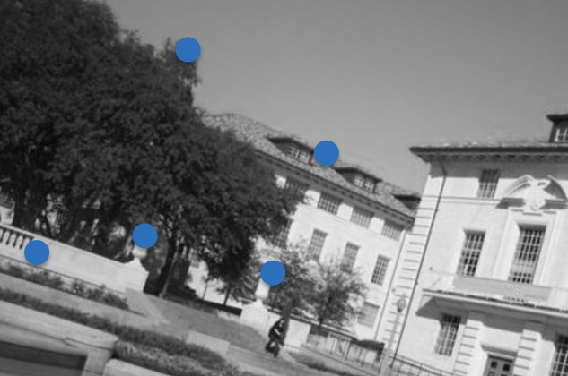
Problem 2: how to fit images?

Slide 18
Outline
Quick review of keypoints and RANSAC
Panorama formulation
Matching corresponding keypoints
Stitching images together with affine transformation

Slide 19
How to know if keypoints are “the same”?
Use keypoint descriptors!

Slide 20
Matching pseudocode
func get_matches(K1, K2, threshold):
matches = []
for every keypoint k1 in K1:
dists = []
for every keypoint k2 in K2:
dists.add({‘dist’: dist(k1, k2) ‘point’: k2})
sort(dists by key ‘dist’)
if dists[0][‘dist’] / dists[1][‘dist’] < threshold:
matches.add((k1, dists[0][‘point’])
return matches
Try this with one for-loop!

Slide 21
Matching result

Slide 22
Outline
Quick review of keypoints and RANSAC
Panorama formulation
Matching corresponding keypoints
Stitching images together with affine transformation

Slide 23
Easy case: pictures taken from same angle

Slide 24
Hard case: pictures taken from diff angles

Slide 25
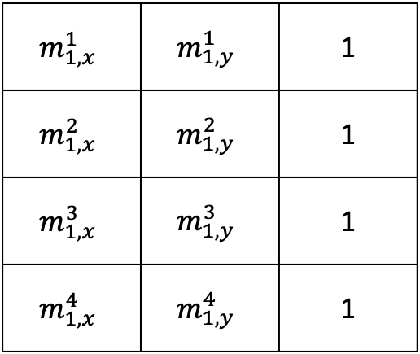
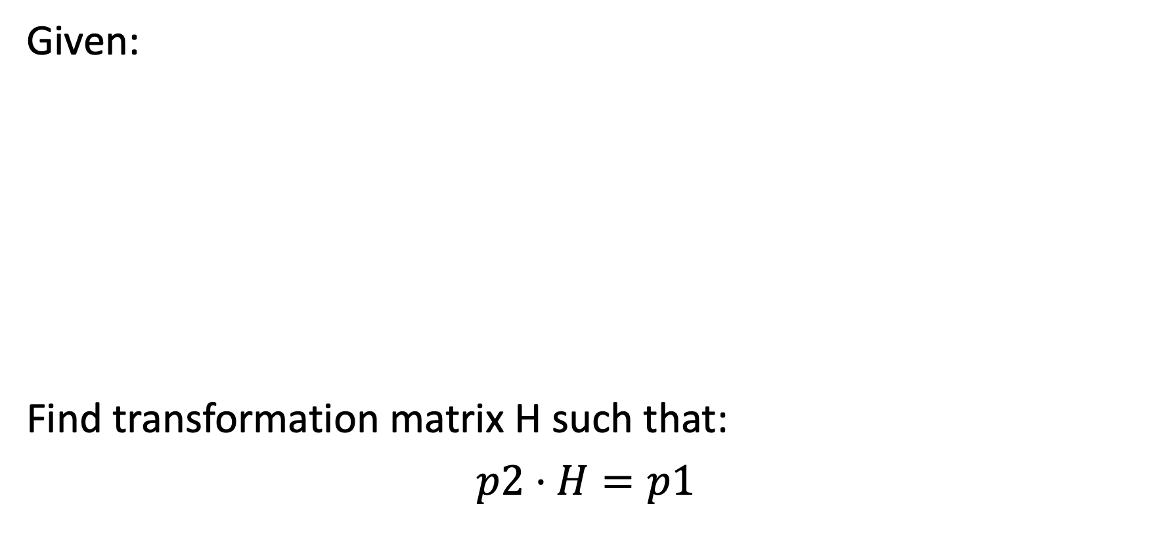
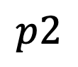
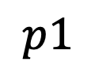
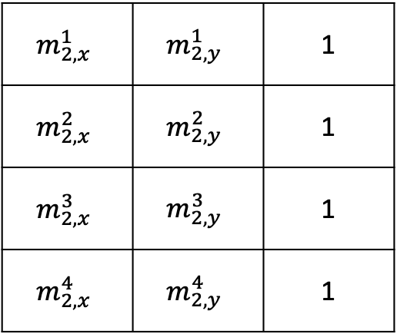
Find transformation between matches
Given:
Find transformation matrix H such that:
$$p2⋅H=p1$$
$$m_{1,x}^{1}$$ | $$m_{1,y}^{1}$$ | 1
$$m_{1,x}^{2}$$ | $$m_{1,y}^{2}$$ | 1
$$m_{1,x}^{3}$$ | $$m_{1,y}^{3}$$ | 1
$$m_{1,x}^{4}$$ | $$m_{1,y}^{4}$$ | 1
$$m_{2,x}^{1}$$ | $$m_{2,y}^{1}$$ | 1
$$m_{2,x}^{2}$$ | $$m_{2,y}^{2}$$ | 1
$$m_{2,x}^{3}$$ | $$m_{2,y}^{3}$$ | 1
$$m_{2,x}^{4}$$ | $$m_{2,y}^{4}$$ | 1
$$p1$$
$$p2$$

Slide 26
What if we have noisy matches?
Refine transformation matrix with RANSAC!

Slide 27
Pick subset

Slide 28
Fit affine matrix and find inliers

Slide 29
Recompute matrix with all inliers and stitch!

Slide 30
Outline
Quick review of keypoints and RANSAC
Panorama formulation
Matching corresponding keypoints
Stitching images together with affine transformation

